Slide 1



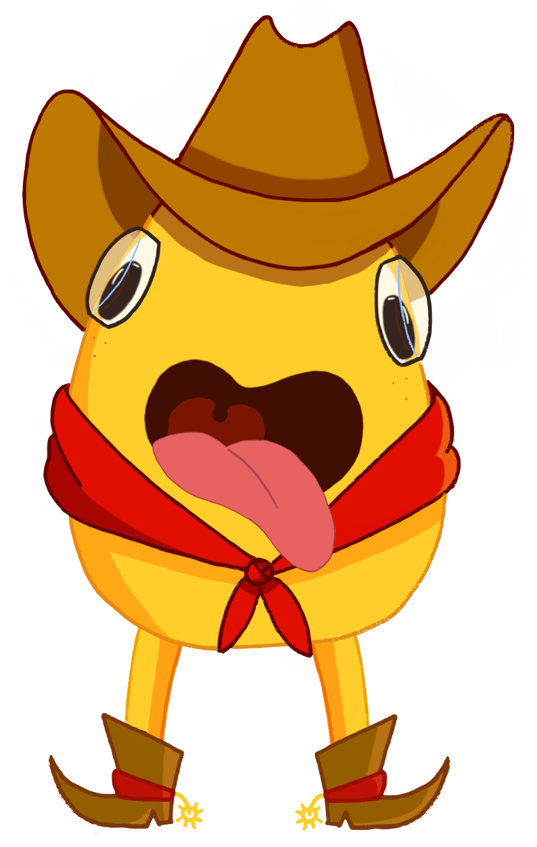


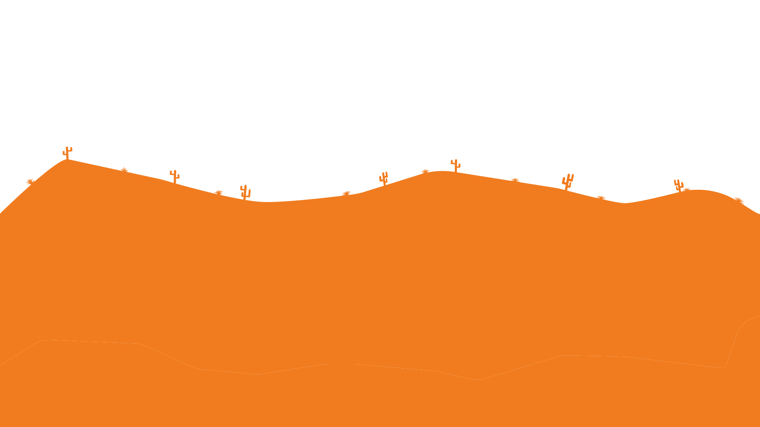


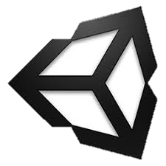

What is tongue and cheek?
Inspired by QWOP and Getting Over It, Tongue and Cheek is a 2D side-scrolling game where the user plays as Cheek, a potato cowboy. Using only its tongue to move around the level and avoid obstacles, Cheek just wants to get back home.
Let’s get Cheeky
By Sam Chami, Merci Magallanes, and John Scott
Software Used
Tongue and Cheek was created in Unity, using C#. The graphics were made using Adobe Photoshop and Autodesk Sketchbook.
Purpose of Tongue and Cheek
We created Tongue and Cheek as a fun, final interdisciplinary challenge since it includes other areas of game creation aside from programming. We also wanted to create a scalable game whose graphics and levels/content could be expanded upon.

